Slide 1
BREAULT SWD TRAINING
Date: Sept 16th, 2024
Attendance: John chu, tom Brixey, jon Herlocker, and pam james
Goal: Explain how to in’s and out’s of github in breaultswd org.

Slide 2
Github navigation
Briefly before we navigated through GITHUB. This serves as a refresher.
Repository: broken out into manageable sized container of code
Project: tracks current and future development
Teams: contains their own projects and links to repos
Inside Repos the menu changes to the one above
Code is the collection of code in each branch of the repo
Issue are associated tasks for the development team to work on (should only be in DEV_ repo)
Pull request are changes to the codespace from a fork of a development branch
Actions: are workflows set on users to preform a task. Not currently being used
Projects: can be repo specific, yet as an organization we are using org projects for better tracking
Wiki: Is documentation and roadmap for the software in the space. Not currently being used
Insights: Are statistics linked to the repo which shows all the changes made
Settings: Shall only be used by admin. This sets rules for the repo.

Slide 3
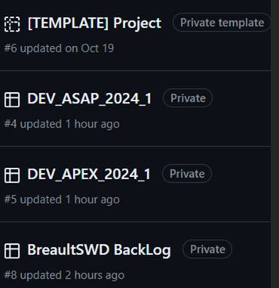
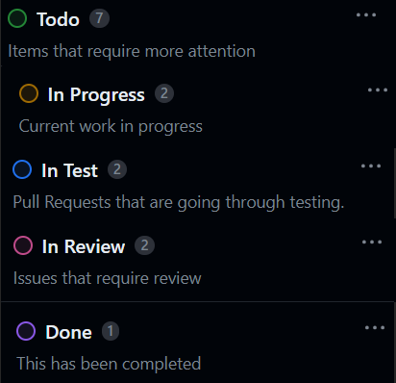
Projects
Tracks development efforts. All Issues and Pull Requests shall be assigned to a Project

Slide 4
Repository
Only the DEV_ repo’s shall have Issues associated.
No development shall be done directly on the BreaultSWD repo’s
All development shall be on forks
All test cases shall be in associated Test_Repo

Slide 5
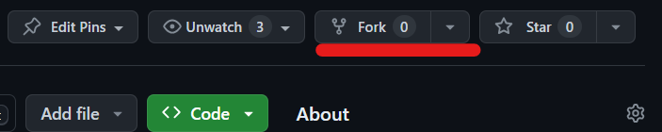
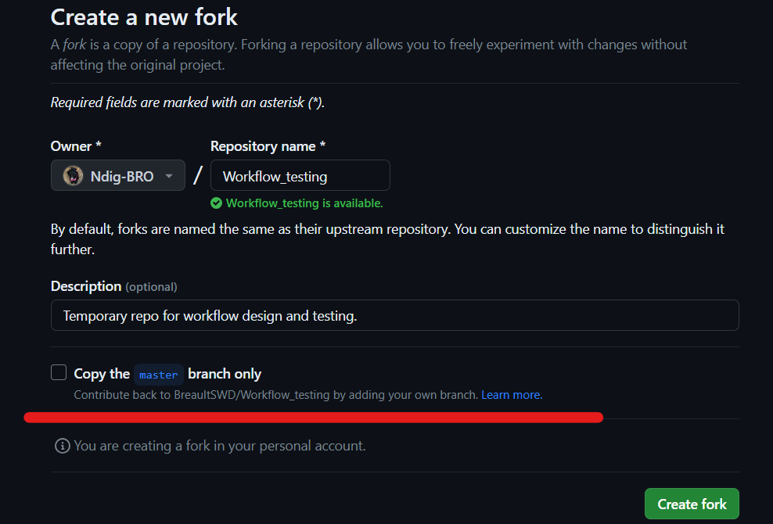
Creating a new fork
Select fork in the given repo
De-select Copy <Trunk> branch only
Create fork
NOTE: if the fork or the repo does not
Have a DEV_ branch before the branch
Is created. This can be done after
If the developer has an existing fork
Creating a branch and syncing can be
Done.

Slide 6
DEV_ repo
All research, development notes, and work completed is uploaded in Design_ branch per-version
Each version branch has a readme that contains: issues completed and link
The readme will aid the release notes per version
All new issues shall be associated to a DEV_ repo

Slide 7


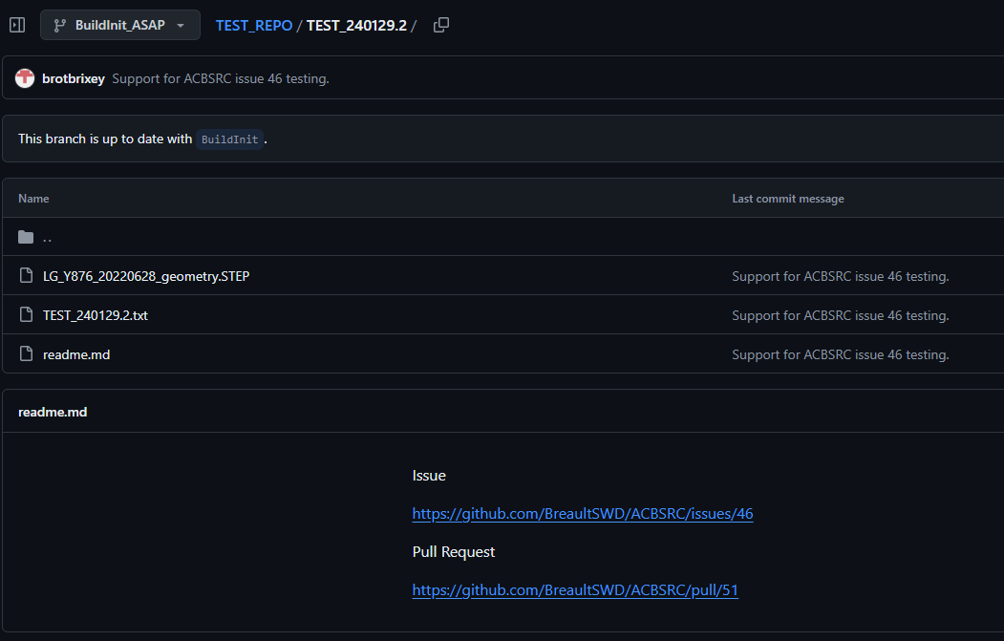
Test_repo
TEST_<DEV_NOTE>.test number
Folder and test txt contains same naming culture
Readme holds the issue and pull-request with links
Any additional file or picture shall be included
Txt has a required format
The test-repo pull-request shall be linked in development to an issue
A test is developed before code is altered.
During the pull-request review and the release testing, the test shall be preformed
Before the release of a new version a release report and sci shall be saved in test_repo branch

Slide 8
Issues
Shall be from the back-log > moved to Current Development
Shall be associated to a DEV_ project
Shall be created on a DEV_ repo
Issues shall be assigned to a Developer
Developer shall not close out issue without review
The reviewer shall close out the issue
Development shall be linked with a pull-request

Slide 9
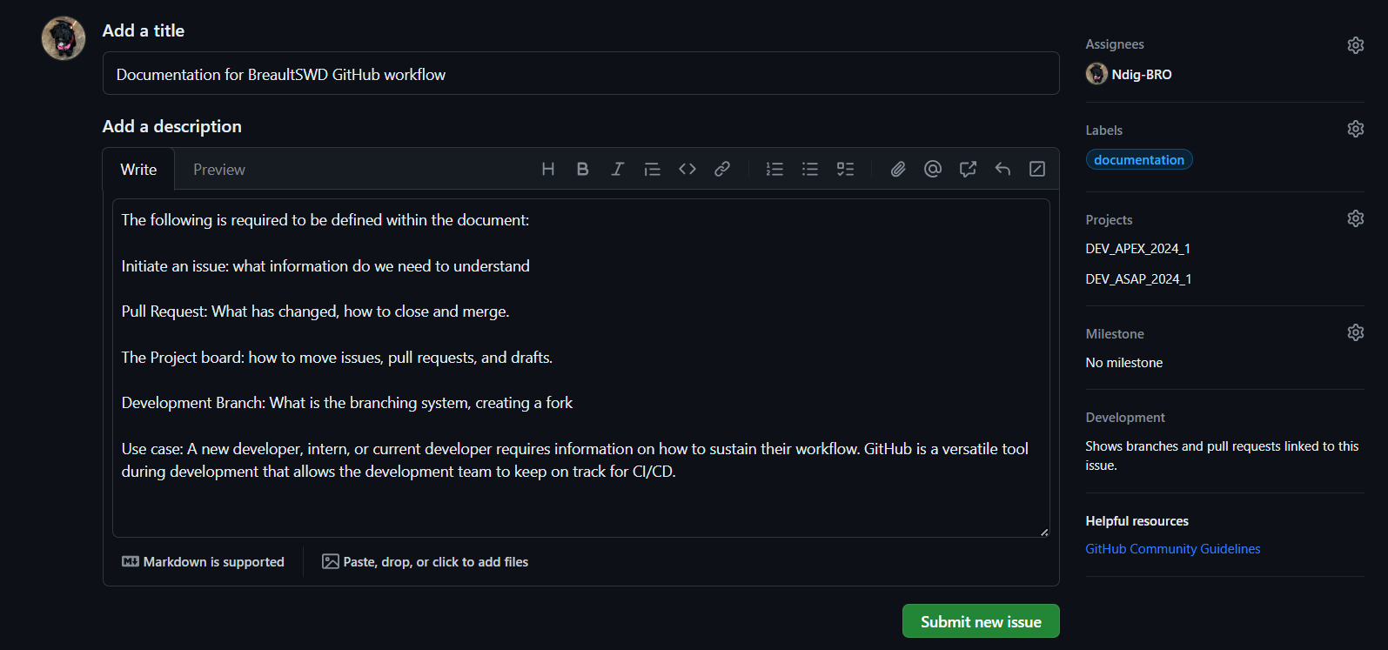
Issues
Most Issues are created as a draft in the Back-log. If the Issue is assigned to a DEV_ repo then it gets assigned
to a Developer. A Label is not required. Project is required to be assigned. Should have Back-log if from a draft.
Description has all required information before the Issue has been researched.

Slide 10


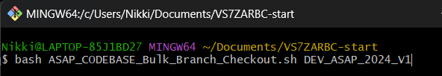

Obtaining the codebase bash files
Bash repo_clone first
Bash bulk_branch <DEV_ branch>
NOTE: this pulls from BreaultSWD and does not create a link to upload to GITHUB.

Slide 11
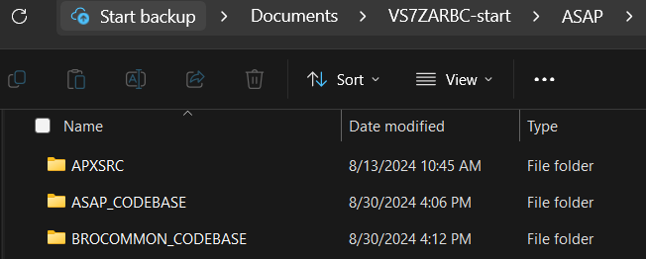
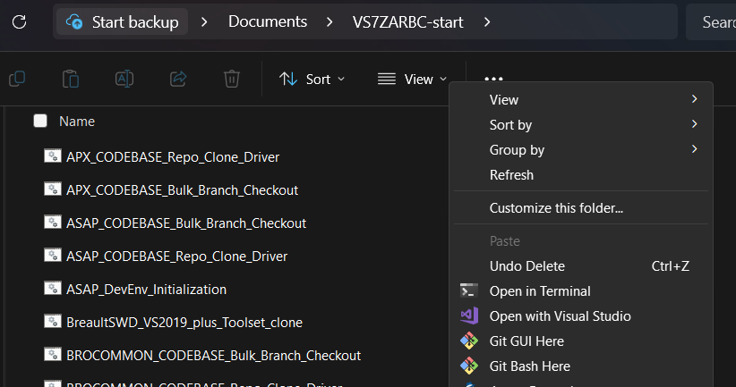
Bash scripts to call for new development
Delete the files within and keep the build anchor folder
From VS7ZARBC call a git bash here

Slide 12
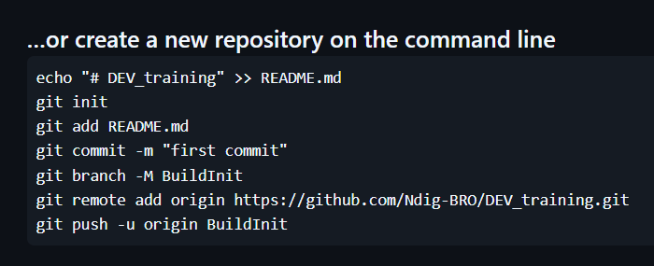
Commits in bash
git init -b <name of the local branch>
Git checkout -b <name of branch>
Add the files to your current local Branch:
git add .
git commit -m “<DEV_note>”
git remote add <name> <URL fork link>
git push <remote> <branch>

Slide 13
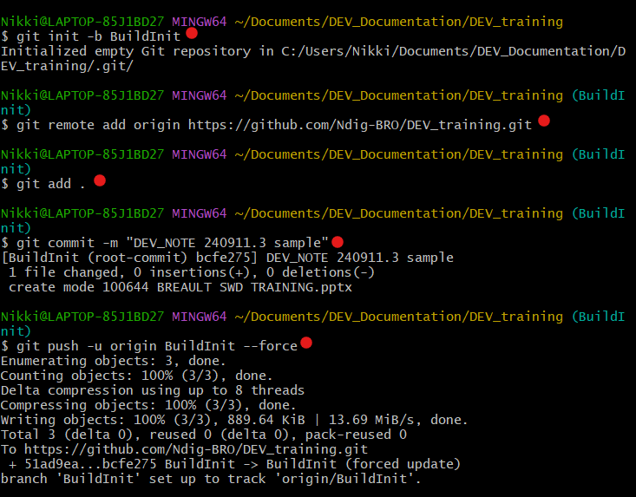
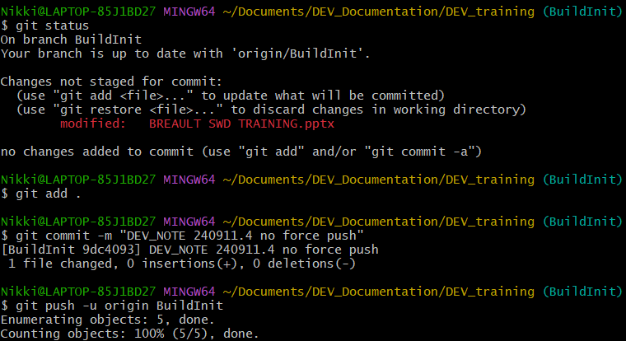
Post bash script pull
Since the code is already in files the commits can be completed with a push ending in - -force.
After the first force to branch of the fork, this is using a push. The developer can remove the force.
If the dev has an open pull-request on the forced root branch it will close the pull-request.

Slide 14
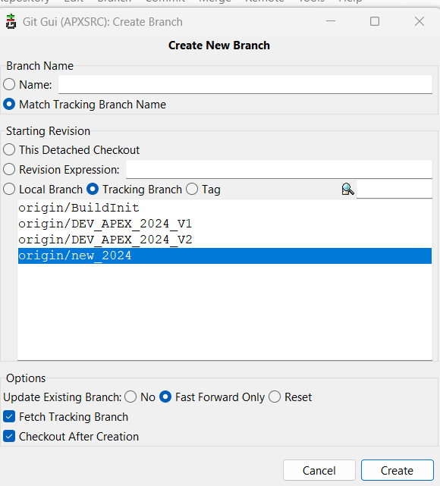
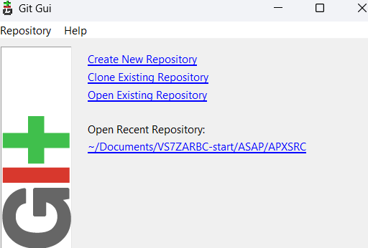
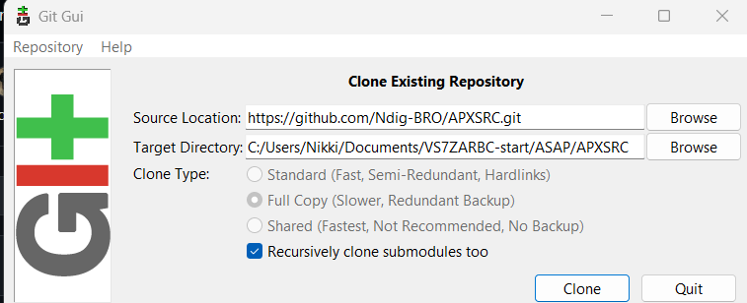
Cloning in git gui
NOTE: The last /APXSRC folder cannot exist in clone

Slide 15
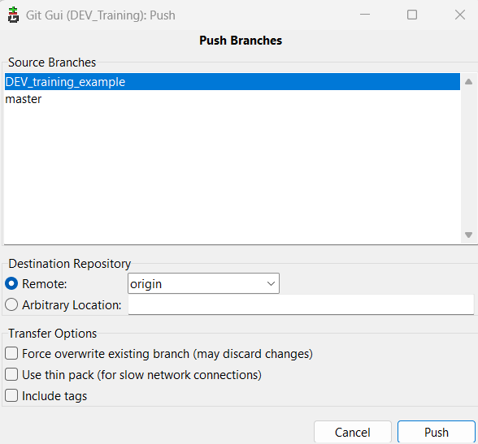
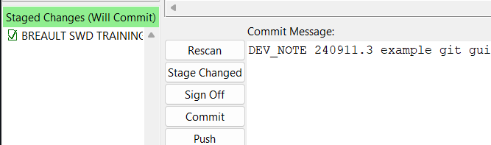
Commits in git gui
Select Rescan
Select Stage Changes
Add a commit message
Commit
Push – this will submit changes to GITHUB

Slide 16
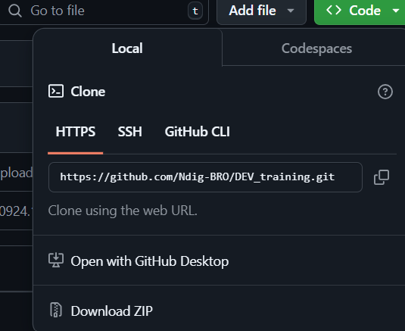
Zip download from github
From the <> Code tab the dev can obtain the git url
Dev team is not currently using GitHub Desktop.
Download zip is easiest to use on the one off obtaining
Files. The problem with getting the whole codespace
Causes a failure loading symbols in the IDE from a
Microsoft security issue. This can be fixed by going
In the file explorer to those files and changing the
Security settings.

Slide 17
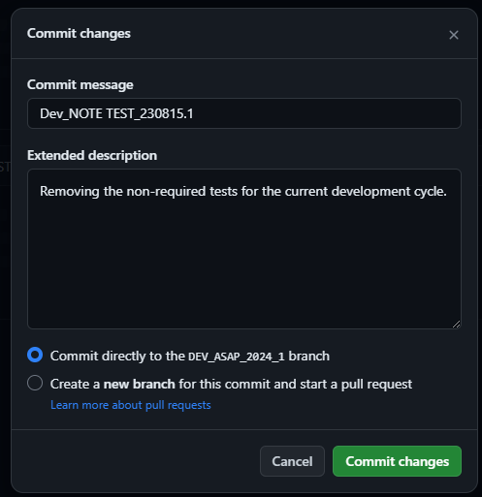
Commits in github
Commits shall only be completed on DEV_
Forks.
Message requires link to the DEV_NOTE
YYMMDD.number
Commits shall be the single event change.
IE Nukem
IE adding a for loop.
Whatever a developer have put in a note in the codespace for shall be the change in the commit message.
NOTE: as a suggestion test before commit.

Slide 18
Pull-request (Development)
Shall be from personal fork to DEV_ branch
Shall never be into BuildInit (should be able to change in edit)
Shall be linked under development in the issue
Can be preformed in git bash, yet shall be within GITHUB
Shall be reviewed by another developer
Reviewer shall merge
If force merge, requires two verifications prior to merge
All requested alterations, commented on code, shall be preformed by author developer, not reviewer (even if simple)
All requests shall be tested and include a test in a Test_Repo pull-request.

Slide 19
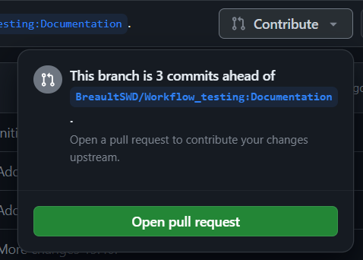
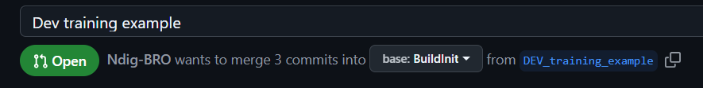
Pull-Request in GITHUB
Select Contribute: Open the Pull Request
The display should show if the code can merge.
Input information about what is completed in the pull-request
If the pull-request requires alteration to a different branch, select edit and select the drop-down

Slide 20
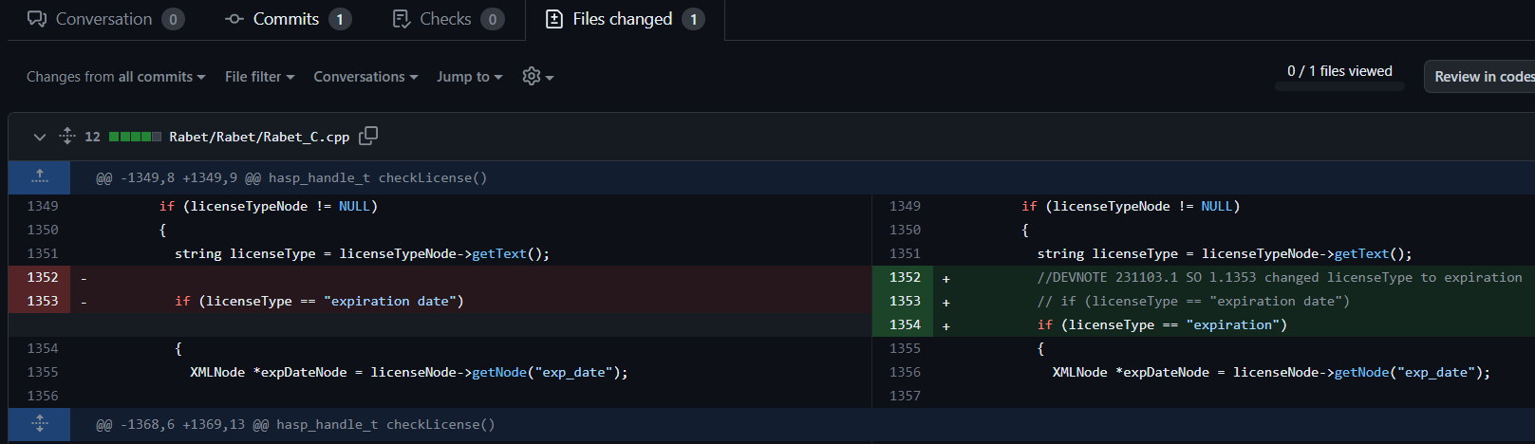
File change in pull-request
Each change made in the codebase is shown under the files changed tab.
Reviewers can add comments in the code locations
Developer can alter the codebase while the pull-request is still active and the changes will update the files changed

Slide 21

tagging
After testing is complete, DEV_ branch have been merged into BuildInit, and the installer is in box. A tag can be created.
A tag shall only be created on BuildInit
Tags shall be generated in bash.
All tags shall be <product>_<year>_<version>
Call for auto-tag: Bash APEX_Release_Tag.sh <name of tag>

